Slide 1



ATM Cash Demand Forecasting
By:
Omar Ragaie
Elena Magdy
Mariam Khaled
Hazem Amr

Slide 2





3
2
4
1
5
Introduction
Explaining Dataset
Changes made to dataset
Dataset
plotting
The Models

Slide 3
Introduction
The problem:
Creating a model the would predict the amount withdrawn from an ATM on given day
The significance:
Adding too little money would cause dissatisfied customers
Adding too much money would cause high insurance and loss to the bank

Slide 4

The Dataset
Our data consisted of 7 features:
The date the ATM was used
The ID of the ATM
Number of transactions performed by the ATM
Amount of cash withdrawn from the ATM
Capacity of the ATM
The day
Workinf day or holiday

Slide 5
Changes made
2 new features:
The day of the date
Is it a working day or not
Nulls in Capacity:
The number of available ATMs was 2694
A subset containing the most used ATM with no missing values was created
Challenges:
We had no data on two month which were April and August

Slide 6
MODELS

Slide 7
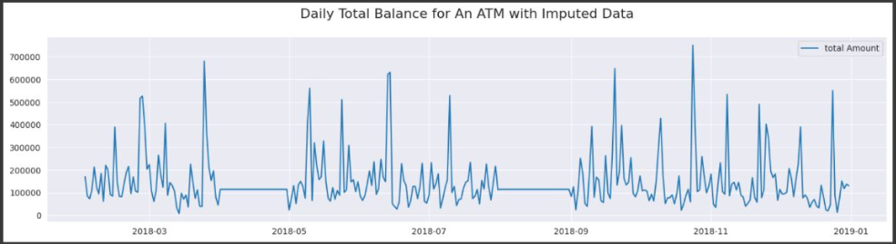
Dataset Plot

Slide 8
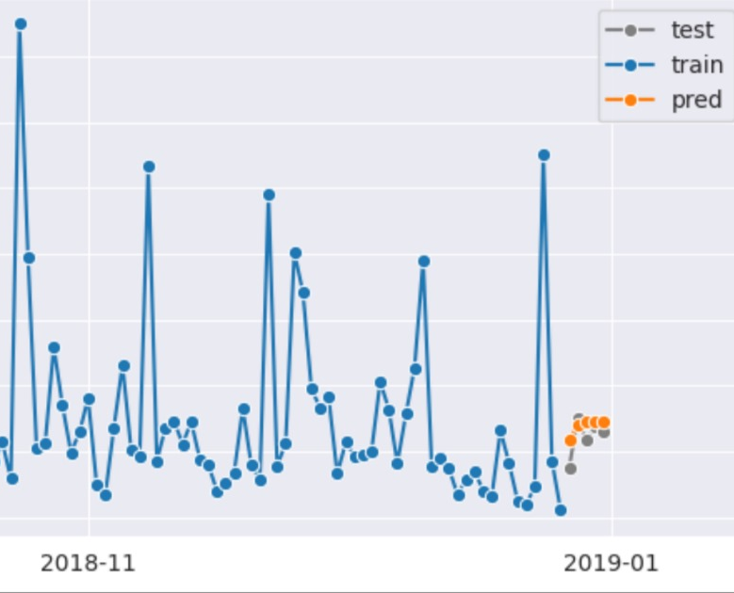
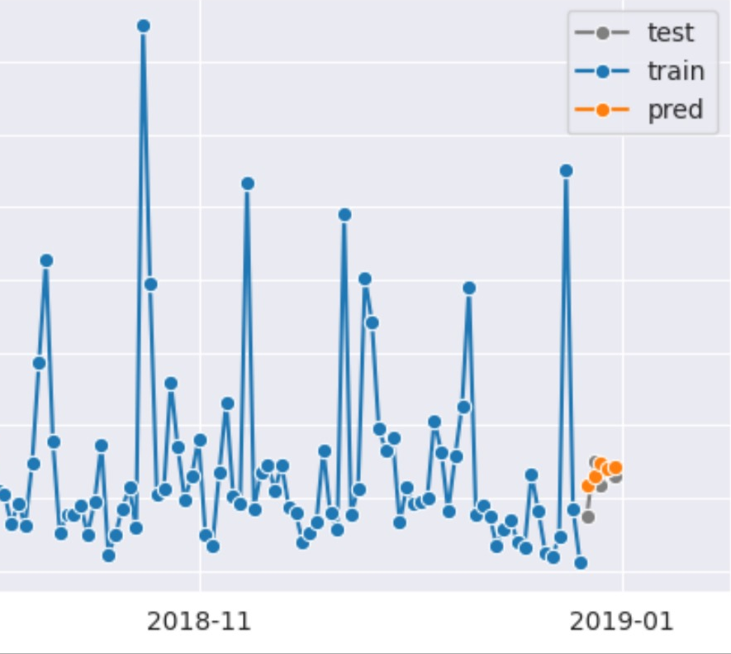
Rolling forecast for AR model
Autoregressive (AR) model

Slide 9
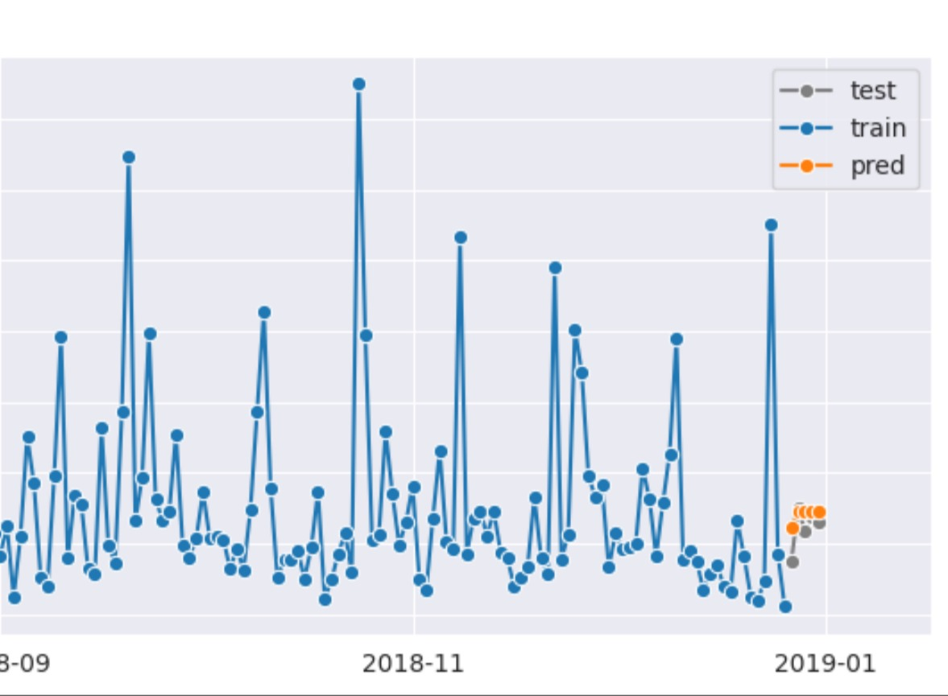
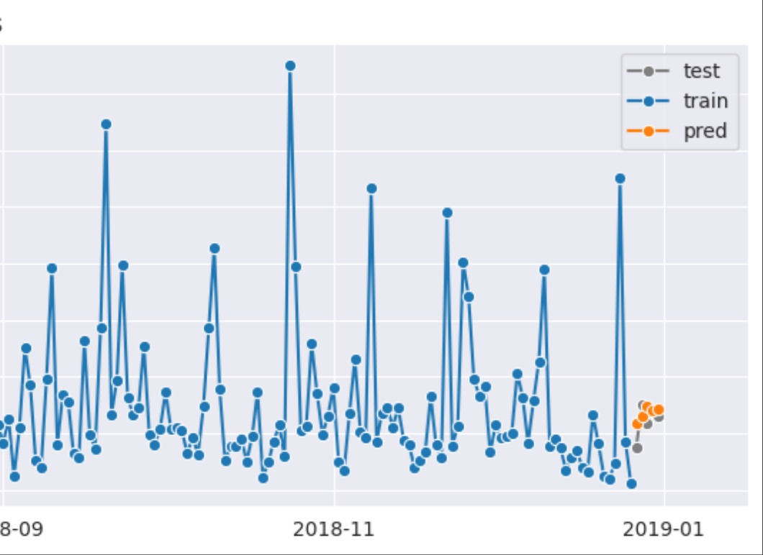
Moving Average (MA) model
Rolling forecast for MA model

Slide 10
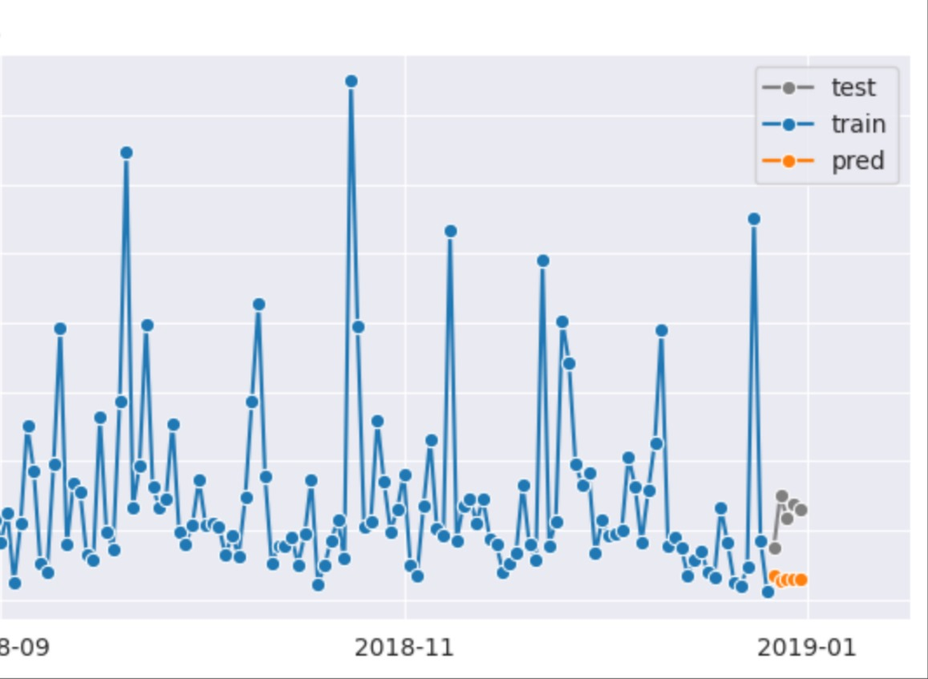

Autoregressive moving average (ARMA)
Rolling forecast for ARMA

Slide 11
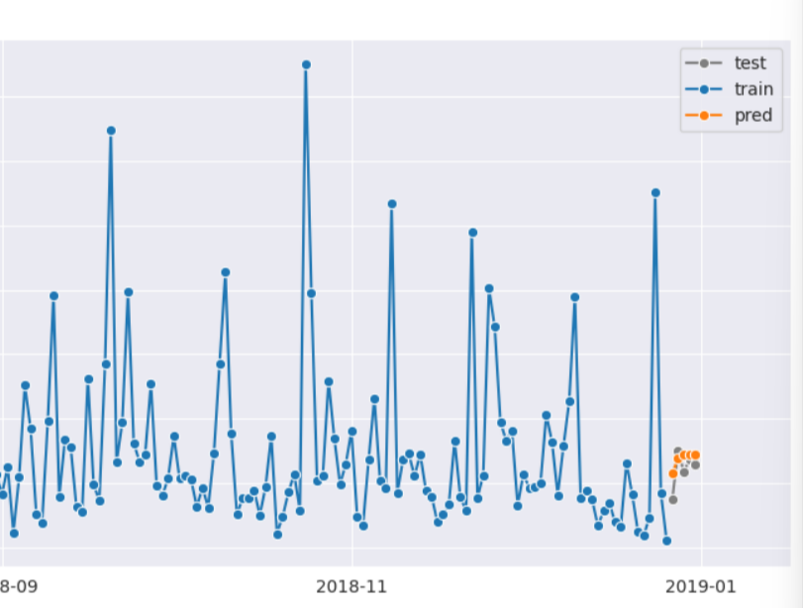
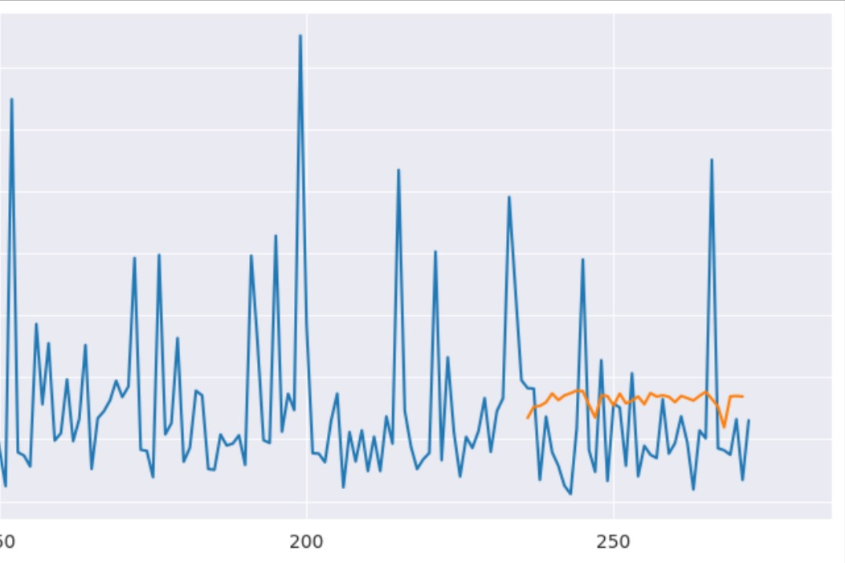
Autoregressive integrated moving average (ARIMA)
Long Short-term Memory (LSTM)

Slide 12
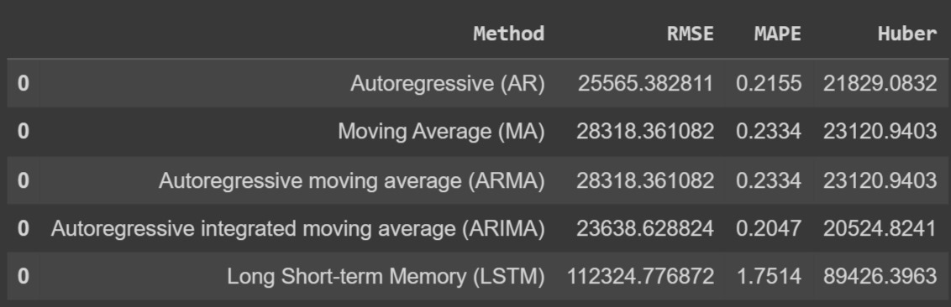
Findings
Error Metrics:
Root mean squared error (RMSE): It's easy to calculate and interpret but can not be used to compare different series, because of their scale dependency. It is also sensitive to outliers.
Mean absolute percentage error (MAPE): It’s scale-independent but it generates infinite or undefined values for zero or close-to-zero actual values and puts a heavier penalty on negative than on positive errors
Huber: It is used in robust regression, that is less sensitive to outliers

Slide 13
Thank You

